Slide 1
Harvesting the Entrepreneurial
Venture

Slide 2
Learning Objectives
To present the concept of “harvest” as a plan for the future.
To examine the key factors in the management succession of a venture.
To identify and describe some of the most important sources of succession
To discuss the potential impact of recent legislation on family business succession
To relate the ways to develop a succession strategy

Slide 3
Learning Objectives (cont’d)
To examine the specifics of an IPO as a potential harvest strategy
To present “selling out” as a final alternative in the harvest strategy

Slide 4
Harvesting the Venture:
A Focus on the Future
Harvest Plan
  Defines how and when the owners and investors will realize an actual cash return on their investment.
Reasons for Harvesting
  To maintain managerial control and succession for successful continued operations.
  To initiate a “liquidity event” that will generate a significant amount of cash for the investors.
  An IPO (initial public offering) has become a reality.
  Most realistic opportunity is a sale of the business.

Slide 5
The Management Succession Strategy
Management Succession
  Is the transition of managerial decision-making
  Is one of the greatest challenges confronting owners and entrepreneurs in privately held businesses.
Research on private firms shows:
  Many go out of existence after 10 years; only 3 out of 10 survive into a second generation.
  Only 16% make it to a third generation.
  Their average life expectancy is 24 years, which is also the average tenure for founders of a business.

Slide 6
^{Table} 15.1 Barriers to Succession Planning in Privately Held Businesses
Founder/Owner | Family
Death anxiety Company as a symbol Loss of identity Concern about legacy Dilemma of choice Fiction of equality Generational envy Loss of power | Death as taboo Discussion is a hostile act Fear of loss/abandonment Fear of sibling rivalry Change of spouse’s position
Source: Manfred F. R. Kets de Vries, “The Dynamics of Family-Controlled Firms: The Good News and the Bad News,” Organizational Dynamics (Winter 1993): 68.

Slide 7
^{Figure} 15.1 Pressures and Interests in a Family Business
 | Inside the Family | Outside the Family
 | Family Managers | Employees
Inside the Business | Hanging onto or getting hold of company control Selection of family members as managers Continuity of family investment and involvement Building a dynasty Rivalry | Rewards for loyalty Sharing of equity, growth, and success Professionalism Bridging family transitions Stake in the company
 | The Relatives | The Outsiders
Outside the Business | Income and inheritance Family conflicts and alliances Degree of involvement in the business | Competition Market, product, supply, and technology influence Tax laws Regulatory agencies
Source: Adapted and reprinted by permission of the Harvard Business Review. An Exhibit from “Transferring Power in the Family Business,” by Louis B. Barnes and Simon A. Hershon (July/August 1976): 106. Copyright © 1976 by the President and Fellows of Harvard College; all rights reserved.

Slide 8
Key Factors in Succession
Succession in a privately held business is a highly charged emotional issue that requires not only structural changes, but cultural changes as well.
Succession includes the transfer of ethics, values, and traditions, along with the actual business itself.
The “family business” and the “business family” are two distinct components that must be dealt with and disentangled if progress toward succession is to be made.

Slide 9
Key Factors in Succession (cont’d)
Pressures and Interests Inside the Firm
  Family members
  Nonfamily employees
Pressures and Interests Outside the Firm
  Family members
  Nonfamily elements
Forcing Events
  Happenings that cause the replacement of the owner-manager:
    Death
    Illness
    Mental or psychological breakdown
    Abrupt departure
    Legal problems
    Severe business decline
    Financial difficulties

Slide 10
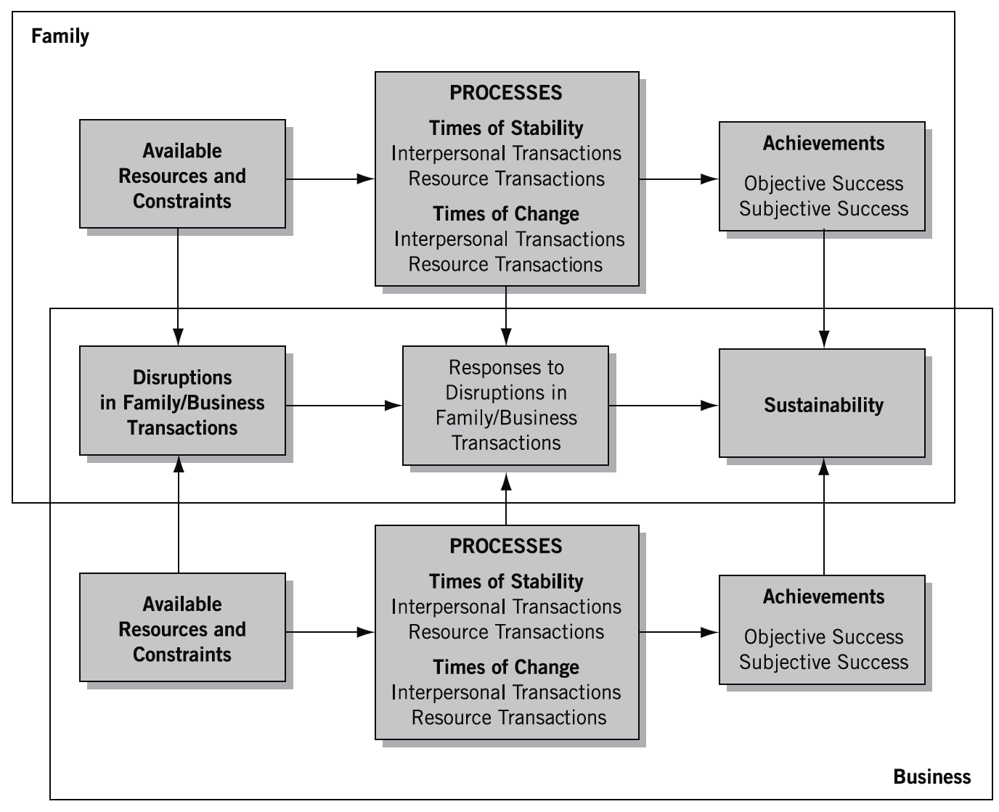
^{Figure} 15.2 Sustainable Family Business Model
Source: Kathryn Stafford, Karen A. Duncan, Sharon Dane, Mary Winter, “A Research Model of Sustainable Family Business,” Family Business Review 12, no. 3 (September 1999): 197–208.

Slide 11
^{Table} 15.2 Comparison of Entry Strategies for Succession in Family Business
 | Advantages | Disadvantages
Early Entry Strategy | Intimate familiarity with the nature of the business and employees is acquired. Skills specifically required by the business are developed. Exposure to others in the business facilitates acceptance and the achievement of credibility. Strong relationships with constituents are readily established. | Conflict results when the owner has difficulty with teaching or relinquishing control to the successor. Normal mistakes tend to be viewed as incompetence in the successor. Knowledge of the environment is limited, and risks of inbreeding are incurred.
Delayed Entry Strategy | The successor’s skills are judged with greater objectivity. The development of self-confidence and growth independent of familial influence are achieved. Outside success establishes credibility and serves as a basis for accepting the successor as a competent executive. Perspective of the business environment is broadened. | Specific expertise and understanding of the organization’s key success factors and culture may be lacking. Set patterns of outside activity may conflict with those prevailing in the family firm. Resentment may result when successors are advanced ahead of long-term employees.
Source: Jeffrey A. Barach, Joseph Ganitsky, James A. Carson, and Benjamin A. Doochin, “Entry of the Next Generation: Strategic Challenge for Family Firms,” Journal of Small Business Management 26, no 2 (April 1988): 53. Reproduced with permission of John Wiley & Sons Ltd.

Slide 12
Sources of Succession
Major Questions:
  Inside or outside successor?
  Which entry strategy will be implemented?
  How will power be transferred?
  Can the successor to gain credibility with the firm’s employees?
Types of Successors
  Entrepreneurial successor
  Managerial successor
  Interim specialist

Slide 13
Legal Restrictions
Privately-held Businesses, Nepotism and Succession Practices:
  Succession case: Oakland Scavenger Company
    “Nepotistic concerns cannot supersede the nation’s paramount goal of equal economic opportunity for all.”
    Almost any small business can be sued by an employee of a different ethnic origin than the owner, based upon not being accorded the same treatment of a son or daughter.

Slide 14

Developing a Succession Strategy
Time
Environmental Factors
Understanding
the Contextual
Aspects
Type of Venture
Entrepreneur’s Vision
Capabilities of Managers

Slide 15
Developing a Succession Strategy (cont’d)
Carrying Out the Succession Plan
  Identify a successor
  Groom an heir
  Agree on a plan
  Consider outside help

Slide 16
Identifying Successor Qualities
Sufficient knowledge of
the business
Fundamental honesty
and capability
Good health; energy, alertness, and perception
Enthusiasm about the enterprise
Personality compatible
with the business
High degree of perseverance
Stability and maturity
Reasonable amount
of aggressiveness
Thoroughness and
a proper respect for detail
Problem-solving ability
Resourcefulness
Ability to plan and organize
Talent to develop people
Personality of a starter and
a finisher; and appropriate agreement with the owner’s philosophy about the business.

Slide 17
Creating a Written Succession Strategy
Types of Succession Strategies
  The owner controls the management continuity strategy entirely.
  The owner consults with selected family members.
  The owner works with professional advisors.
  The owner works with family involvement.
  The owner formulates buy/sell agreements at the outset of the firm, or soon thereafter, and whenever a major change occurs.
  The owner considers employee stock ownership plans (ESOPs).
  The owner sells or liquidates the business when losing enthusiasm for it but is still physically able to go on.
  The owner sells or liquidates after discovering a terminal illness but still has time for the orderly transfer of management or ownership.

Slide 18
The Exit Strategy: Liquidity Events
Entrepreneurs consider selling their venture for numerous reasons:
  Boredom and burnout
  Lack of operating and growth capital
  No heirs to leave the business to
  Desire for liquidity
  Aging and health problems
  Desire to pursue other interests

Slide 19
^{Table} 15.3 The IPO Process
Present proposal to the board.
Restate financial statements and refocus the company
Find an underwriter and execute a “letter of intent.”
Draft prospectus.
Respond to due diligence.
Select a financial printer.
Assemble the syndicate.
Perform the road show.
Prepare, revise, and print the prospectus.
Price the offering.
Determine the offering size.
Source: Adapted from Going Public (New York: The NASDAQ Stock Market, Inc., 2005), 5–9 updated for accuracy February, 2015.

Slide 20
^{Table} 15.4 The Registration Process
Preliminary meeting to discuss issue
Form selection
Initial meeting of working group
Second meeting of working group
Meeting of board of directors
Meeting of company counsel with underwriters
Meeting of working group
Prefiling conference with SEC staff
Additional meetings of working group
Meeting with board of directors
Meeting of working group
Filing registration statement with SEC
Distribution of “red herring” prospectus
Receipt of letter of comments
Meeting of working group
Due diligence meeting
Pricing amendment
Notice of acceptance
Statement becomes effective
Source: From K. Fred Skousen, An Introduction to the SEC, 5th ed.. © 1991 Cengage Learning; see also K. Fred Skousen, Steven Glover, and Douglas Prawitt, An Introduction to Corporate Governance and the SEC (Mason, PH; Cengage Learning, 2004).

Slide 21
The Initial Public Offering (IPO): Prospectus
History and nature of the company
Capital structure
Description of any material contracts
Description of securities being registered
Salaries and security holdings of major officers and directors and the price they paid for holdings
Underwriting arrangements
Estimate and use of net proceeds
Audited financial statements
Information about the competition with an estimation of the chances of the company’s survival

Slide 22
Annual Reports: Disclosure Requirements
Audited financial statements: balance sheets for the past 2 years and income and funds statements for the past 3 years
Five years of selected financial data
Management’s discussion and analysis of financial conditions and results of operations
A brief description of the business
Line-of-business disclosures for the past three fiscal years
Directors and executive officers
The market in which the firm’s securities are traded
Range of market prices and dividends for each quarter of the two most recent fiscal years
An offer to provide a free copy of the 10-K report

Slide 23
SEC-Required Forms
Form S-1
  Information contained in the prospectus and other additional financial data
Form 10-Q
  Quarterly financial statements and a summary of all important events that took place during the three-month period
Form 8-K
  A report of unscheduled material events or corporate changes filed with the SEC within 15 days after the end of a month in which a significant material event transpired
Proxy statements
  Information given in connection with a proxy solicitation

Slide 24
Complete Sale of the Venture
Steps for Selling a Business
  Step 1: Prepare a financial analysis
  Step 2: Segregate assets
  Step 3: Value the business
  Step 4: Identify the appropriate timing
  Step 5: Publicize the offer to sell
  Step 6: Finalize the prospective buyers
  Step 7: Remain involved through the closing
  Step 8: Communicate after the sale

Slide 25
Key Terms and Concepts
buy/sell agreements
delayed entry strategy
early entry strategy
employee stock ownership plans (ESOPs)
entrepreneurial successor
exit strategy
forcing events
harvest strategy
initial public offering (IPO)
liquidity event
management succession
managerial successor
nepotism
Oakland Scavenger Company

